Slide 1
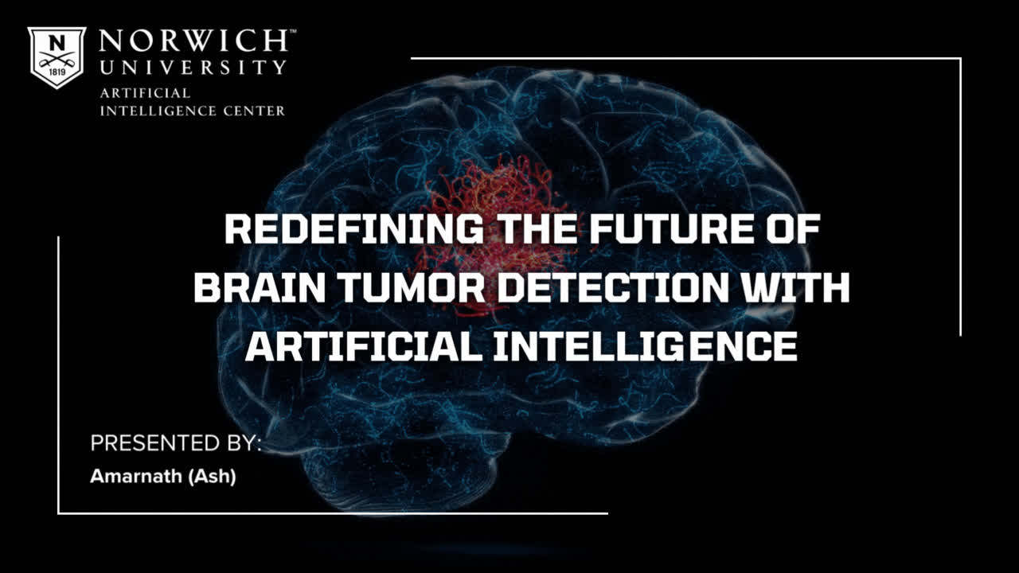

Slide 2




TABLE OF CONTENTS
Why this Research?
What is Transfer Learning?
Model Development Pipeline
Results
Future Directions
Limitations
Acknowledgements
01
02
03
04
05
06
07

Slide 3
WHY THIS RESEARCH?

Slide 4

Did you know?
According to the American brain tumor association.....

Slide 5



Brain and other nervous system cancer is the 10th leading cause of death for men and women.

Slide 6
Over 1 million people are living with brain tumors, and approximately 90,000 new people are diagnosed with primary brain tumors in the U.S. annually.

Slide 7
Around 12,800 adolescents/
young adults and 3,400 children are diagnosed with primary brain tumors each year in the U.S.

Slide 8

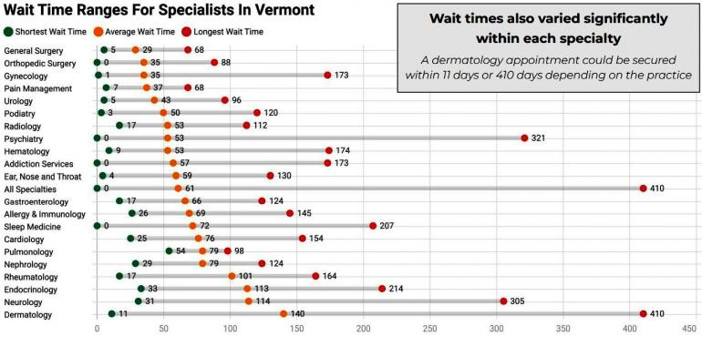
WAIT TIME FOR SPECIALISTS
IN VERMONT

Slide 9
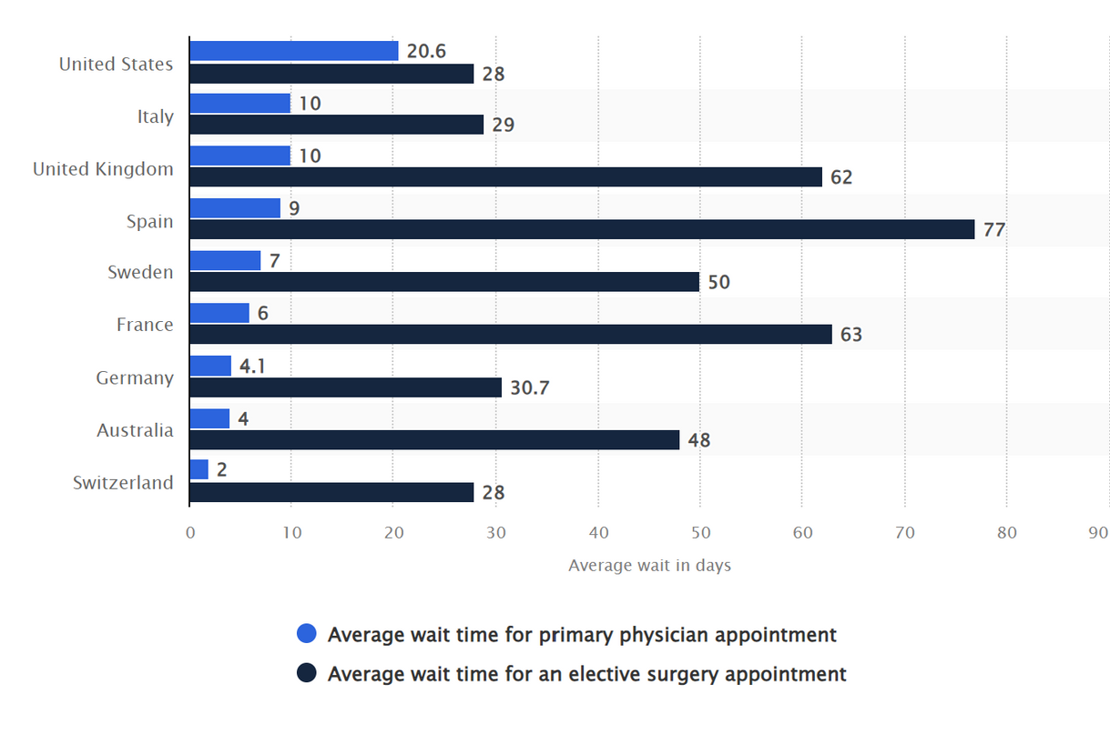
THE AVERAGE WAIT TIME FOR
PRIMARY PHYSCIANS

Slide 10

By integrating AI-powered brain tumor detection systems, we aim to reduce this wait time and enable faster, more accurate diagnoses, leading to improved patient care and outcomes.

Slide 11
WHAT IS TRANSFER LEARNING?

Slide 12



TRANSFER LEARNING
Oh! That’s how you ride a bicycle

Slide 13


TRANSFER LEARNING
Now that I’ve observed bicycle riding, I can leverage that knowledge to learn how to ride a bike myself efficiently using transfer learning.

Slide 14

INTRODUCING THE FIVE MODELS
ResNet50
Xception
EfficientNetV2-S
ResNet152V2
VGG16

Slide 15
MODEL DEVELOPMENT PIPELINE

Slide 16


MODEL DEVELOPMENT PIPELINE
01
02
03
Data Pre-Processing
Model Architecture
Model Training

Slide 17
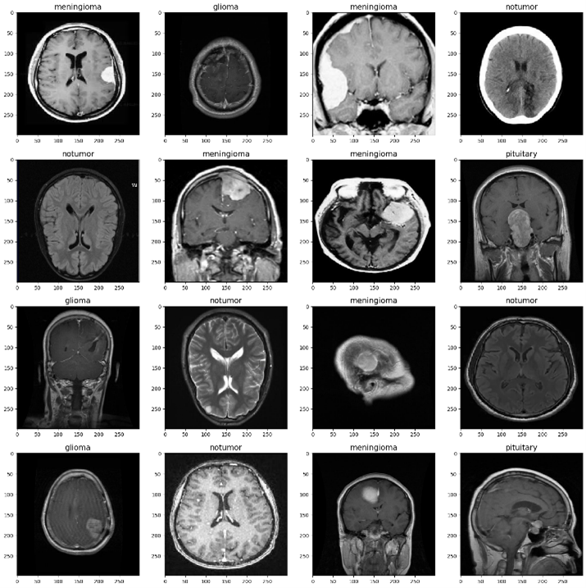

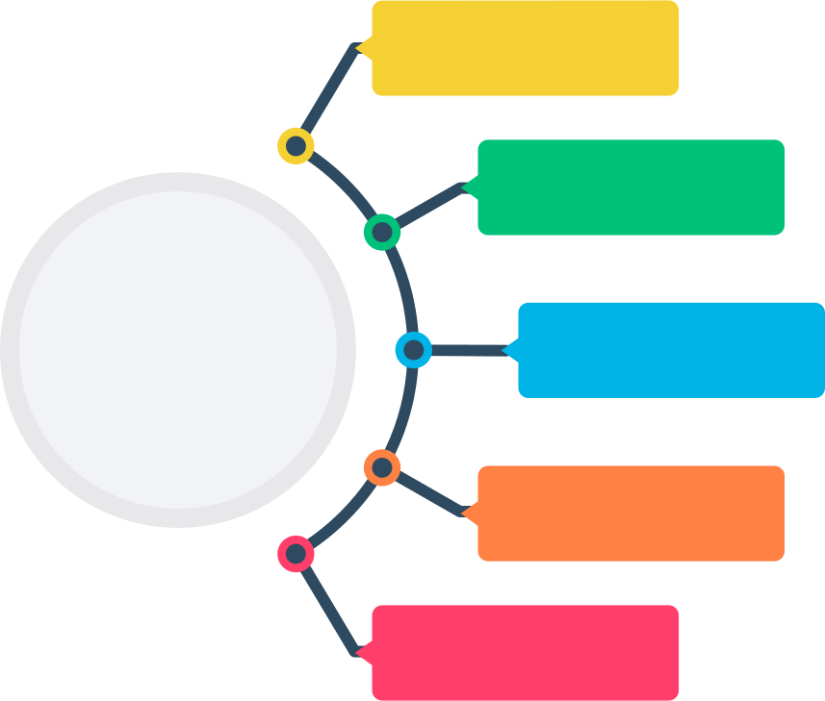
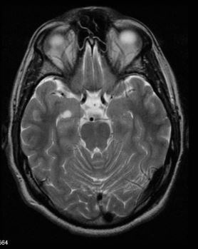
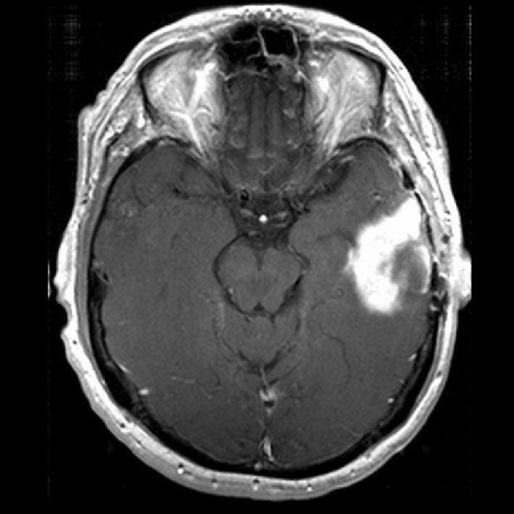

01
DATA PREPROCESSING
BRIGHTNESS
MENINGIOMA
ROTATION
GLIOMA
ZOOM
PITUITARY
NO TUMOR
FLIP
SHEAR

Slide 18



02
MODEL ARCHITECTURE
Pre-trained
Model
Dropout
(0.3)
Dense
(256, relu)
Flatten
Batch
Normalization
Dropout
(0.3)
Dense
(4, softmax)

Slide 19
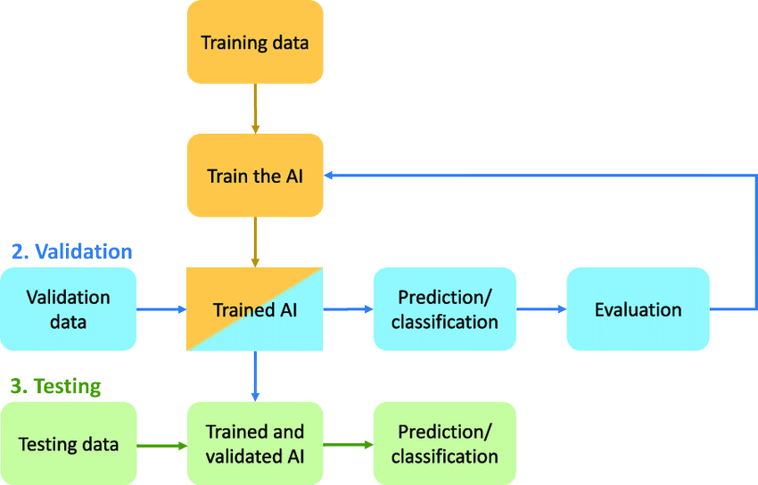
03
TRAIN, VALIDATE & TEST

Slide 20
RESULTS

Slide 21
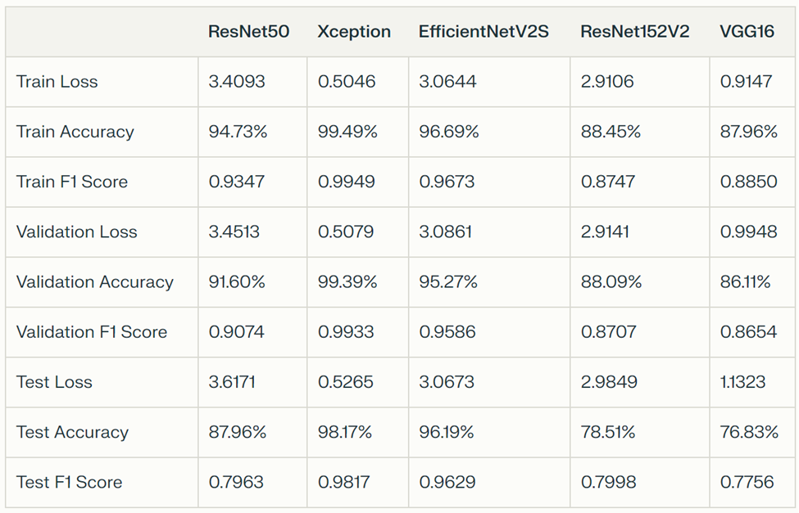


Slide 22
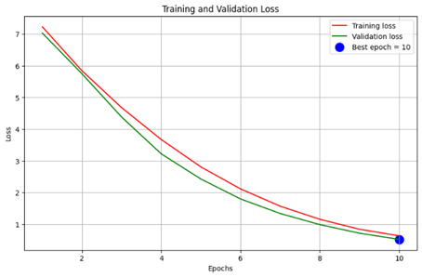
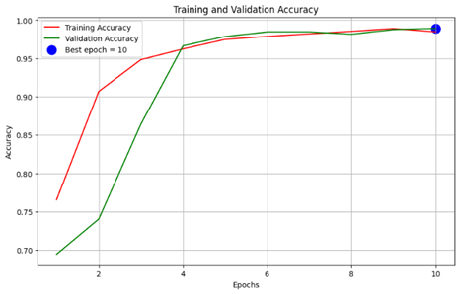
XCEPTION

Slide 23
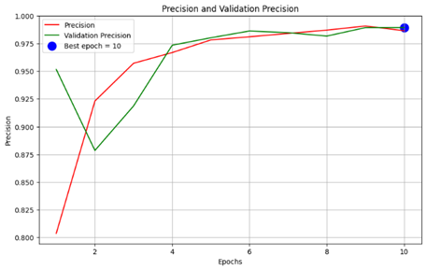
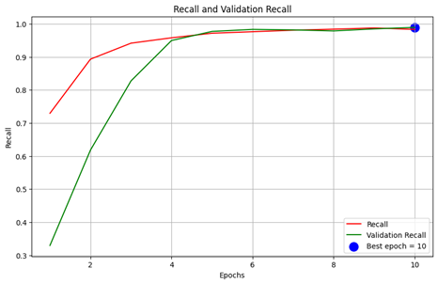
XCEPTION

Slide 24
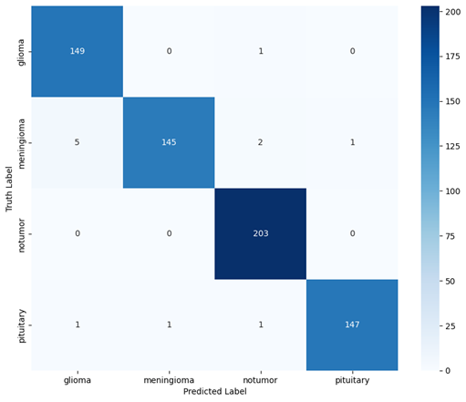
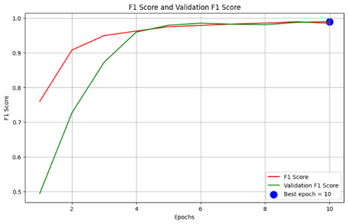
XCEPTION

Slide 25
FUTURE DIRECTIONS

Slide 26

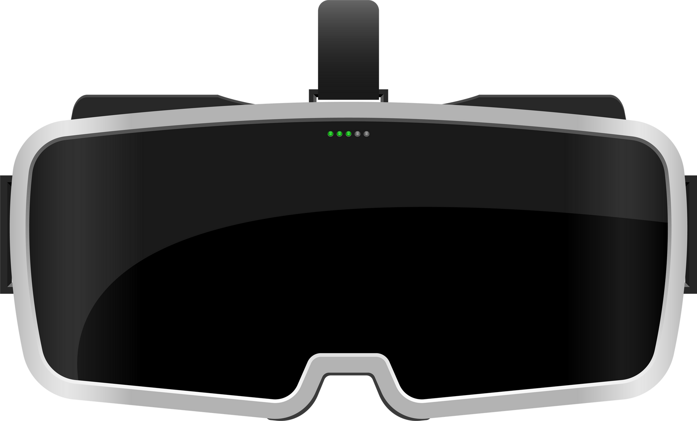


FUTURE AR
TUMOR DETECTOR

Slide 27
Limitations

Slide 28
Data Diversity: The limited diversity of available MRI datasets may restrict the model's ability to generalize across different demographic groups or clinical scenarios.
Region-Specific Classification: The classification of brain tumors into a limited number of regions, such as Glioma, Meningioma, and Pituitary, may overlook other tumor subtypes or variations, potentially impacting the model's diagnostic accuracy and clinical relevance.
Clinical Adoption Challenges: AI model interpretability and integration into healthcare workflows require additional clinician training and regulatory approvals for widespread adoption.

Slide 29
Acknowledgments

Slide 30
I would like to express my sincere gratitude to:
Professor Hansen, my research mentor, for the invaluable guidance and support throughout the project.
Professor Ali, my research mentor and Director of the AI Center, for his mentorship, the opportunity to work as an AI Fellow, and for funding this project.
Norwich University and the Undergraduate Research Department for funding the trip to this conference.
The organizers of the NCUR conference for this wonderful opportunity to present my findings.

Slide 31

ANY QUESTIONS?

Slide 32
Thank
You

